Slide 1

CODEMETRIC TECHNOLOGY
SWEN BULLETINS
ALLEN, SCOTT NICHOLAS
180923 / 620099245
CLARKE, KHADEJA RENEE
180908 / 620098443
NEILL, MISCHKA ZOILA
180913 / 620100135

Slide 2
AGENDA
INTRODUCTION OF TEAM MEMBERS AND THEIR CONTRIBUTIONS TO THE PROJECT
CONCEPT
OVERVIEW OF APPLICATION
BREAKDOWN / DEMO OF APPLICATION
CHALLENGES
FUTURE IMPLEMENTATIONS
QUESTIONS AND COMMENTARY

Slide 3
INTRODUCTION OF TEAM MEMBERS AND THEIR CONTRIBUTIONS TO THE PROJECT

Slide 4
CONCEPT

Slide 5
OVERVIEW OF APPLICATION

Slide 6
OVERVIEW OF APPLICATION
CLIENT
BUILD LANGUAGES: SWIFT 4
DATABASE:
FIREBASE REAL-TIME DATABASE

Slide 7
BREAKDOWN & DEMO OF APPLICATION

Slide 8
BREAKDOWN OF APPLICATION (cont’d)
USER AUTHNTICATION

Slide 9
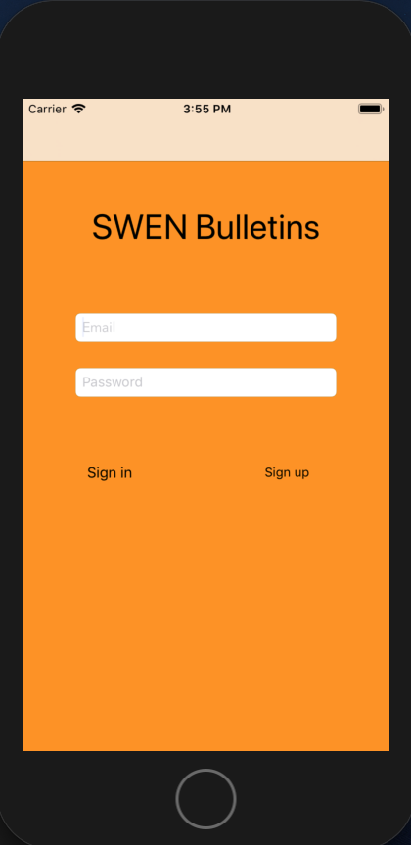
USER AUTHENTICATION
LOGIN

Slide 10
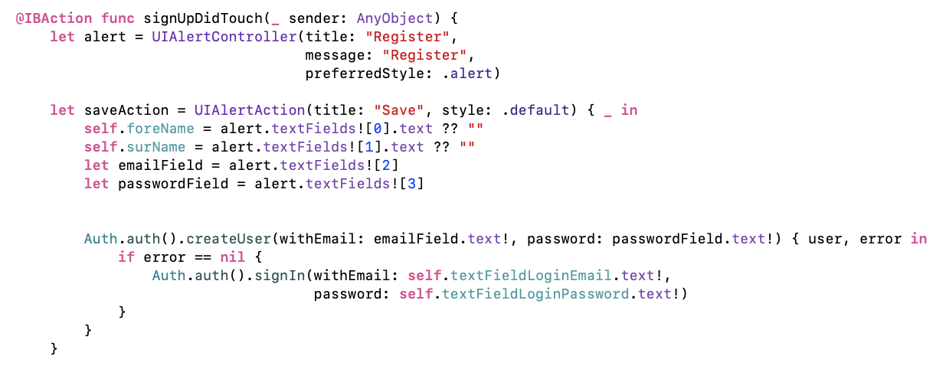
USER AUTHENTICATION
ON CLICK OF SIGN UP BUTTON

Slide 11
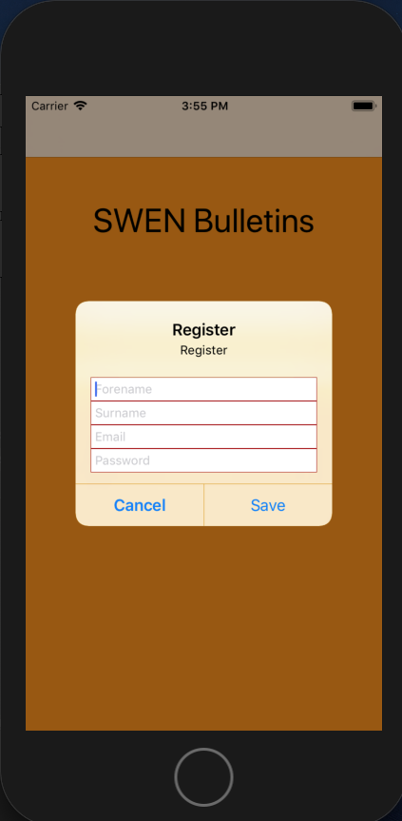
USER AUTHENTICATION
SIGN UP DIALOG

Slide 12
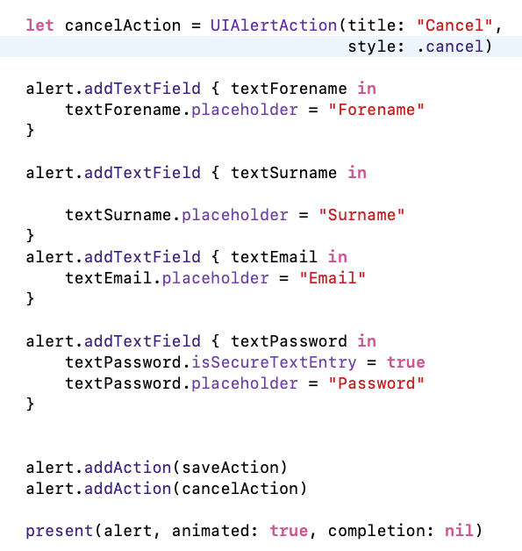
USER AUTHENTICATION
HANDLING OF BUTTON CLICKS ON SIGN UP DIALOG

Slide 13
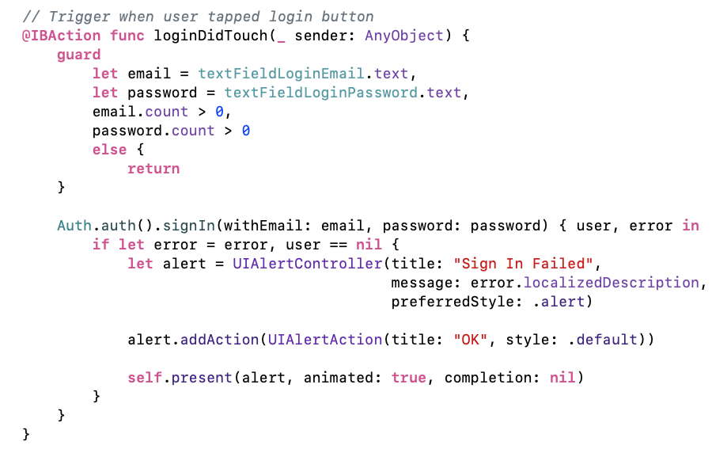
USER AUTHENTICATION
ON CLICK OF LOGIN BUTTON

Slide 14
BREAKDOWN OF APPLICATION (cont’d)
VIEWING ALL BULLETINS

Slide 15
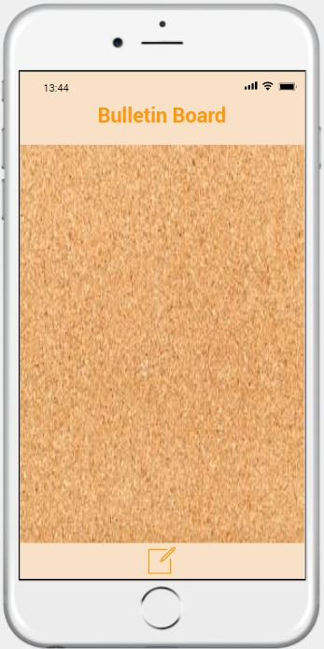
VIEWING ALL BULLETINS
BLANK

Slide 16
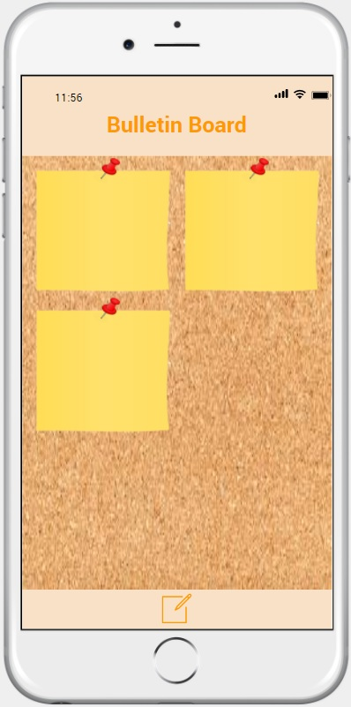
VIEWING ALL BULLETINS
POPULATED

Slide 17
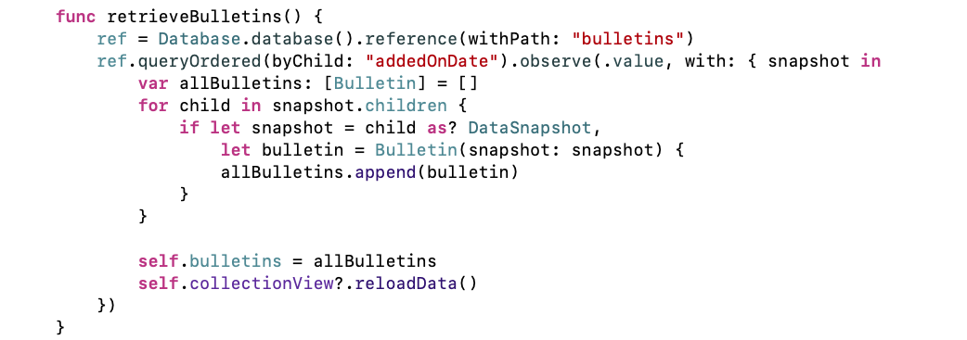
VIEWING ALL BULLETINS
RETRIEVE BULLETINS

Slide 18
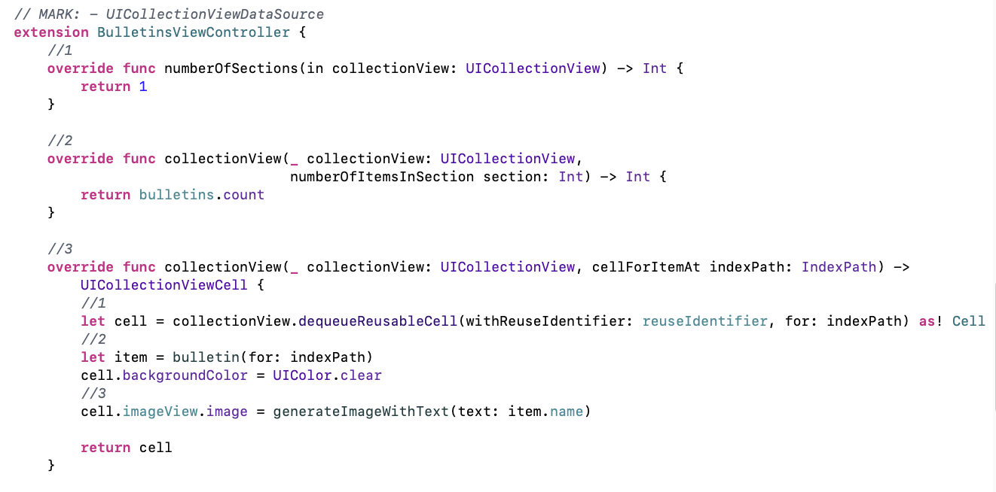
VIEWING ALL BULLETINS
COLLECTION VIEW DATA SOURCE

Slide 19
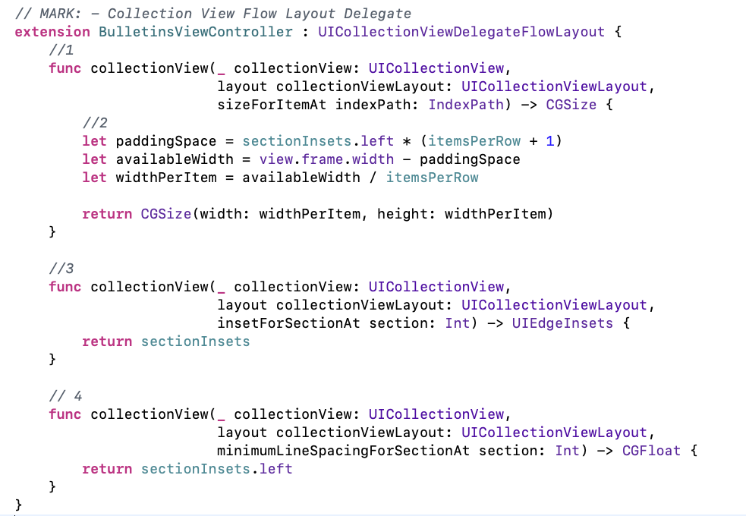
VIEWING ALL BULLETINS
COLLECTION VIEW FLOW LAYOUT DELEGATE

Slide 20
BREAKDOWN OF APPLICATION (cont’d)
CREATING A NEW BULLETIN

Slide 21
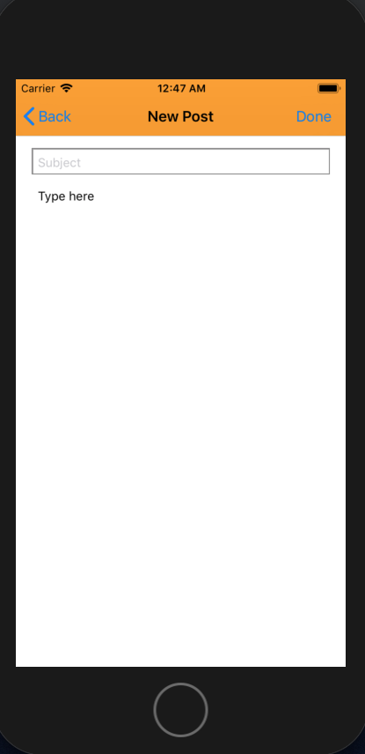
CREATING A NEW BULLETIN
BLANK FIELDS

Slide 22
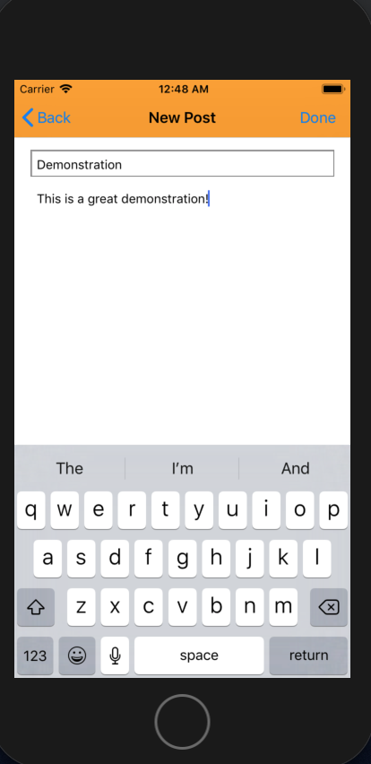
CREATING A NEW BULLETIN
COMPLETED FIELDS

Slide 23
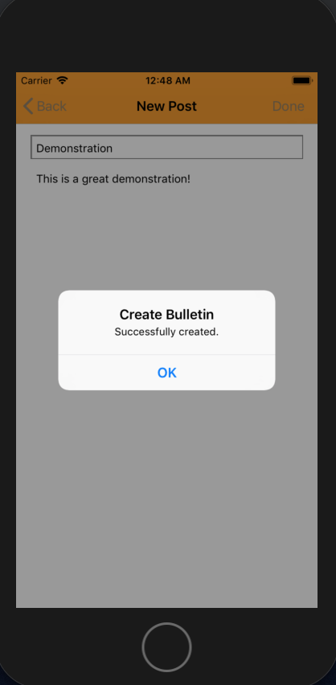
CREATING A NEW BULLETIN
DIALOG FOR SUCCESSFUL CREATION

Slide 24
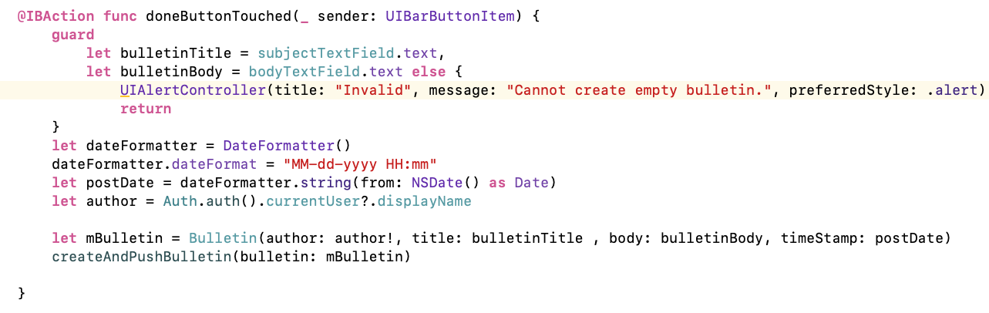
CREATING A NEW BULLETIN
HANDLING ON CLICK OF DONE BUTTON

Slide 25
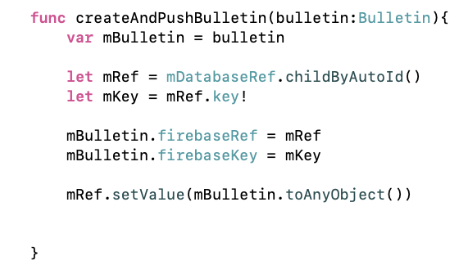
CREATING A NEW BULLETIN
WRITING TO THE DATABASE

Slide 26
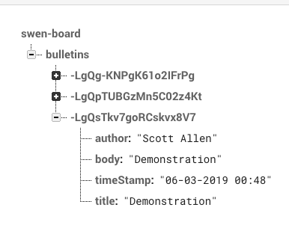
CREATING A NEW BULLETIN
DATABASE STRUCTURE

Slide 27
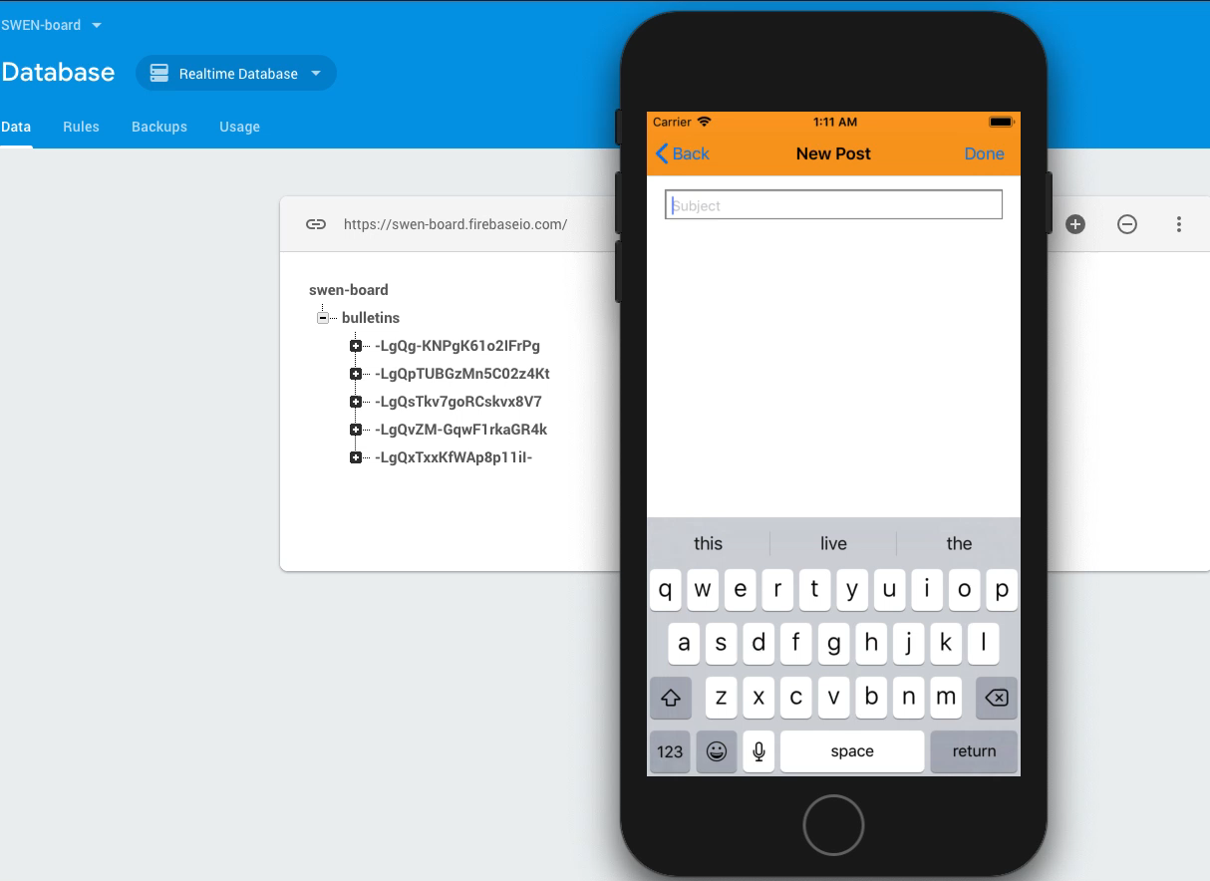
RUNNING APPLICATION – CREATING A NEW BULLETIN

Slide 28
BREAKDOWN OF APPLICATION (cont’d)
VIEWING A BULLETIN

Slide 29
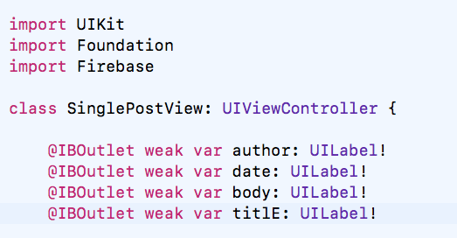
VIEWING A BULLETIN
LABELS

Slide 30
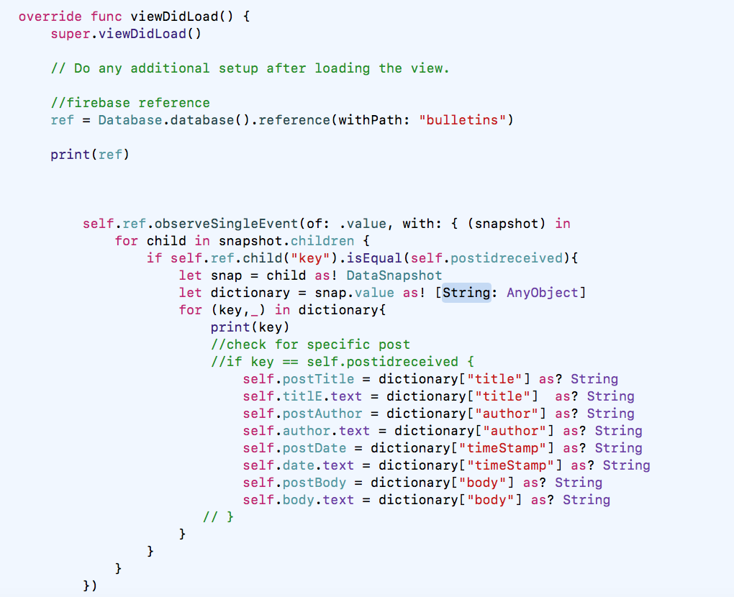
VIEWING A BULLETIN
RETRIEVING ITEM FROM DATABASE

Slide 31
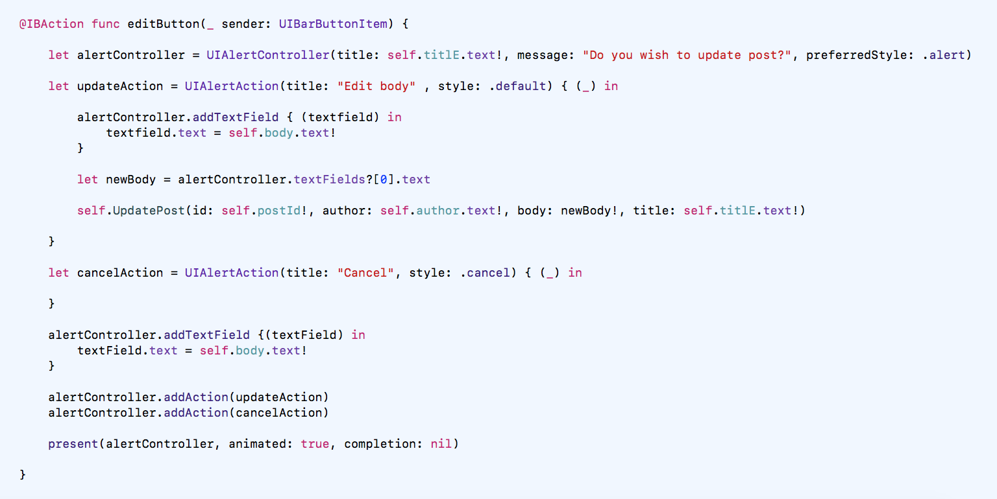
VIEWING A BULLETIN
DIALOG FOR EDITING A BULLETIN

Slide 32
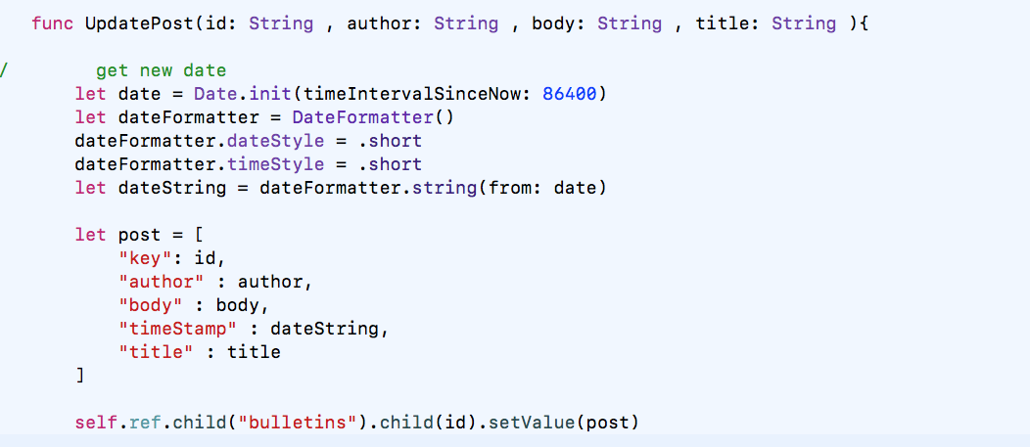
VIEWING A BULLETIN
UPDATING ITEM ON DATABASE

Slide 33
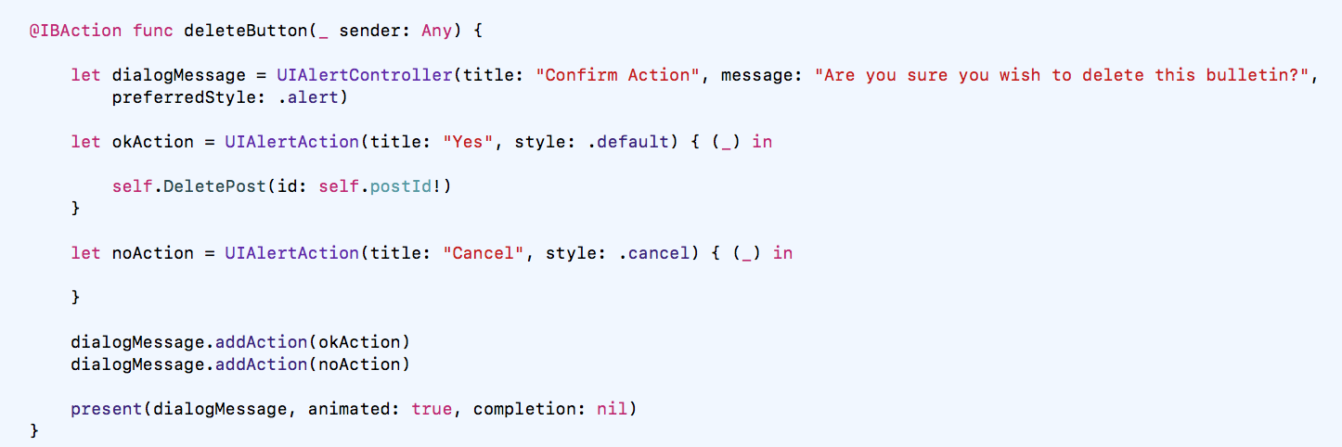
VIEWING A BULLETIN
DIALOG FOR DELETING A BULLETIN

Slide 34
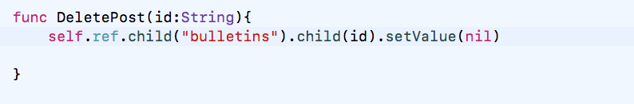
VIEWING A BULLETIN
DELETING ITEM FROM DATABASE

Slide 35
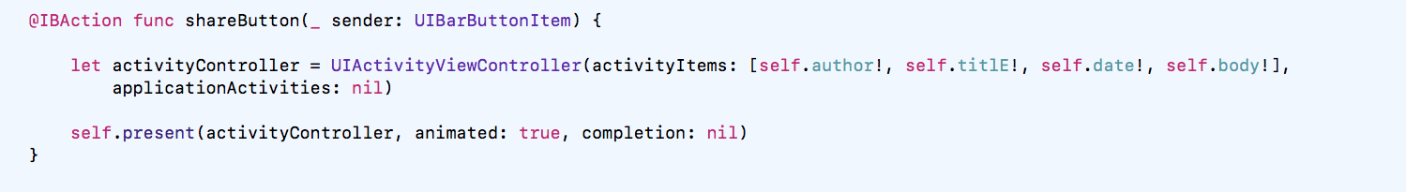
VIEWING A BULLETIN
SHARING A BULLETIN

Slide 36
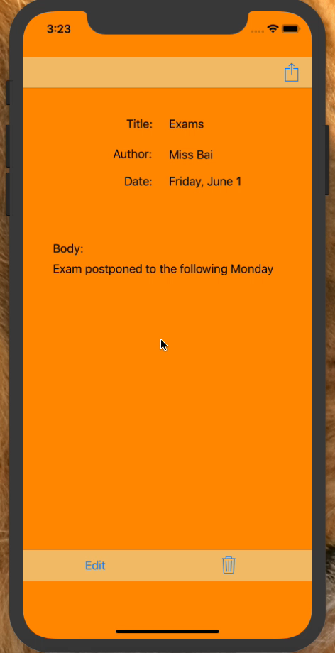
RUNNING APPLICATION – VIEWING A BULLETIN

Slide 37
CHALLENGES

Slide 38
CHALLENGES
Connectivity issues
Dated online resources
Limitations due to internal workings

Slide 39
FUTURE IMPLEMENTATIONS

Slide 40
FUTURE IMPLEMENTATIONS
Search
Replacing Firebase with another Remote Server/Database

Slide 41
QUESTIONS and COMMENTS

